Slide 1



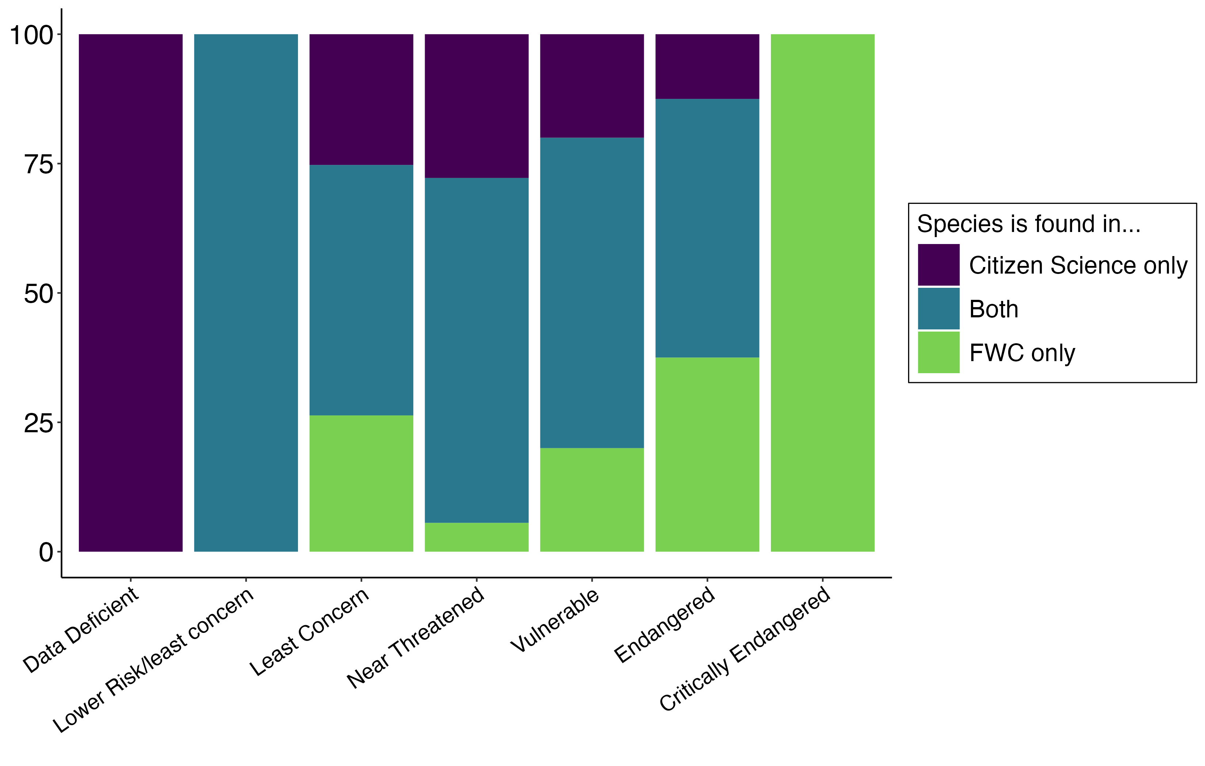
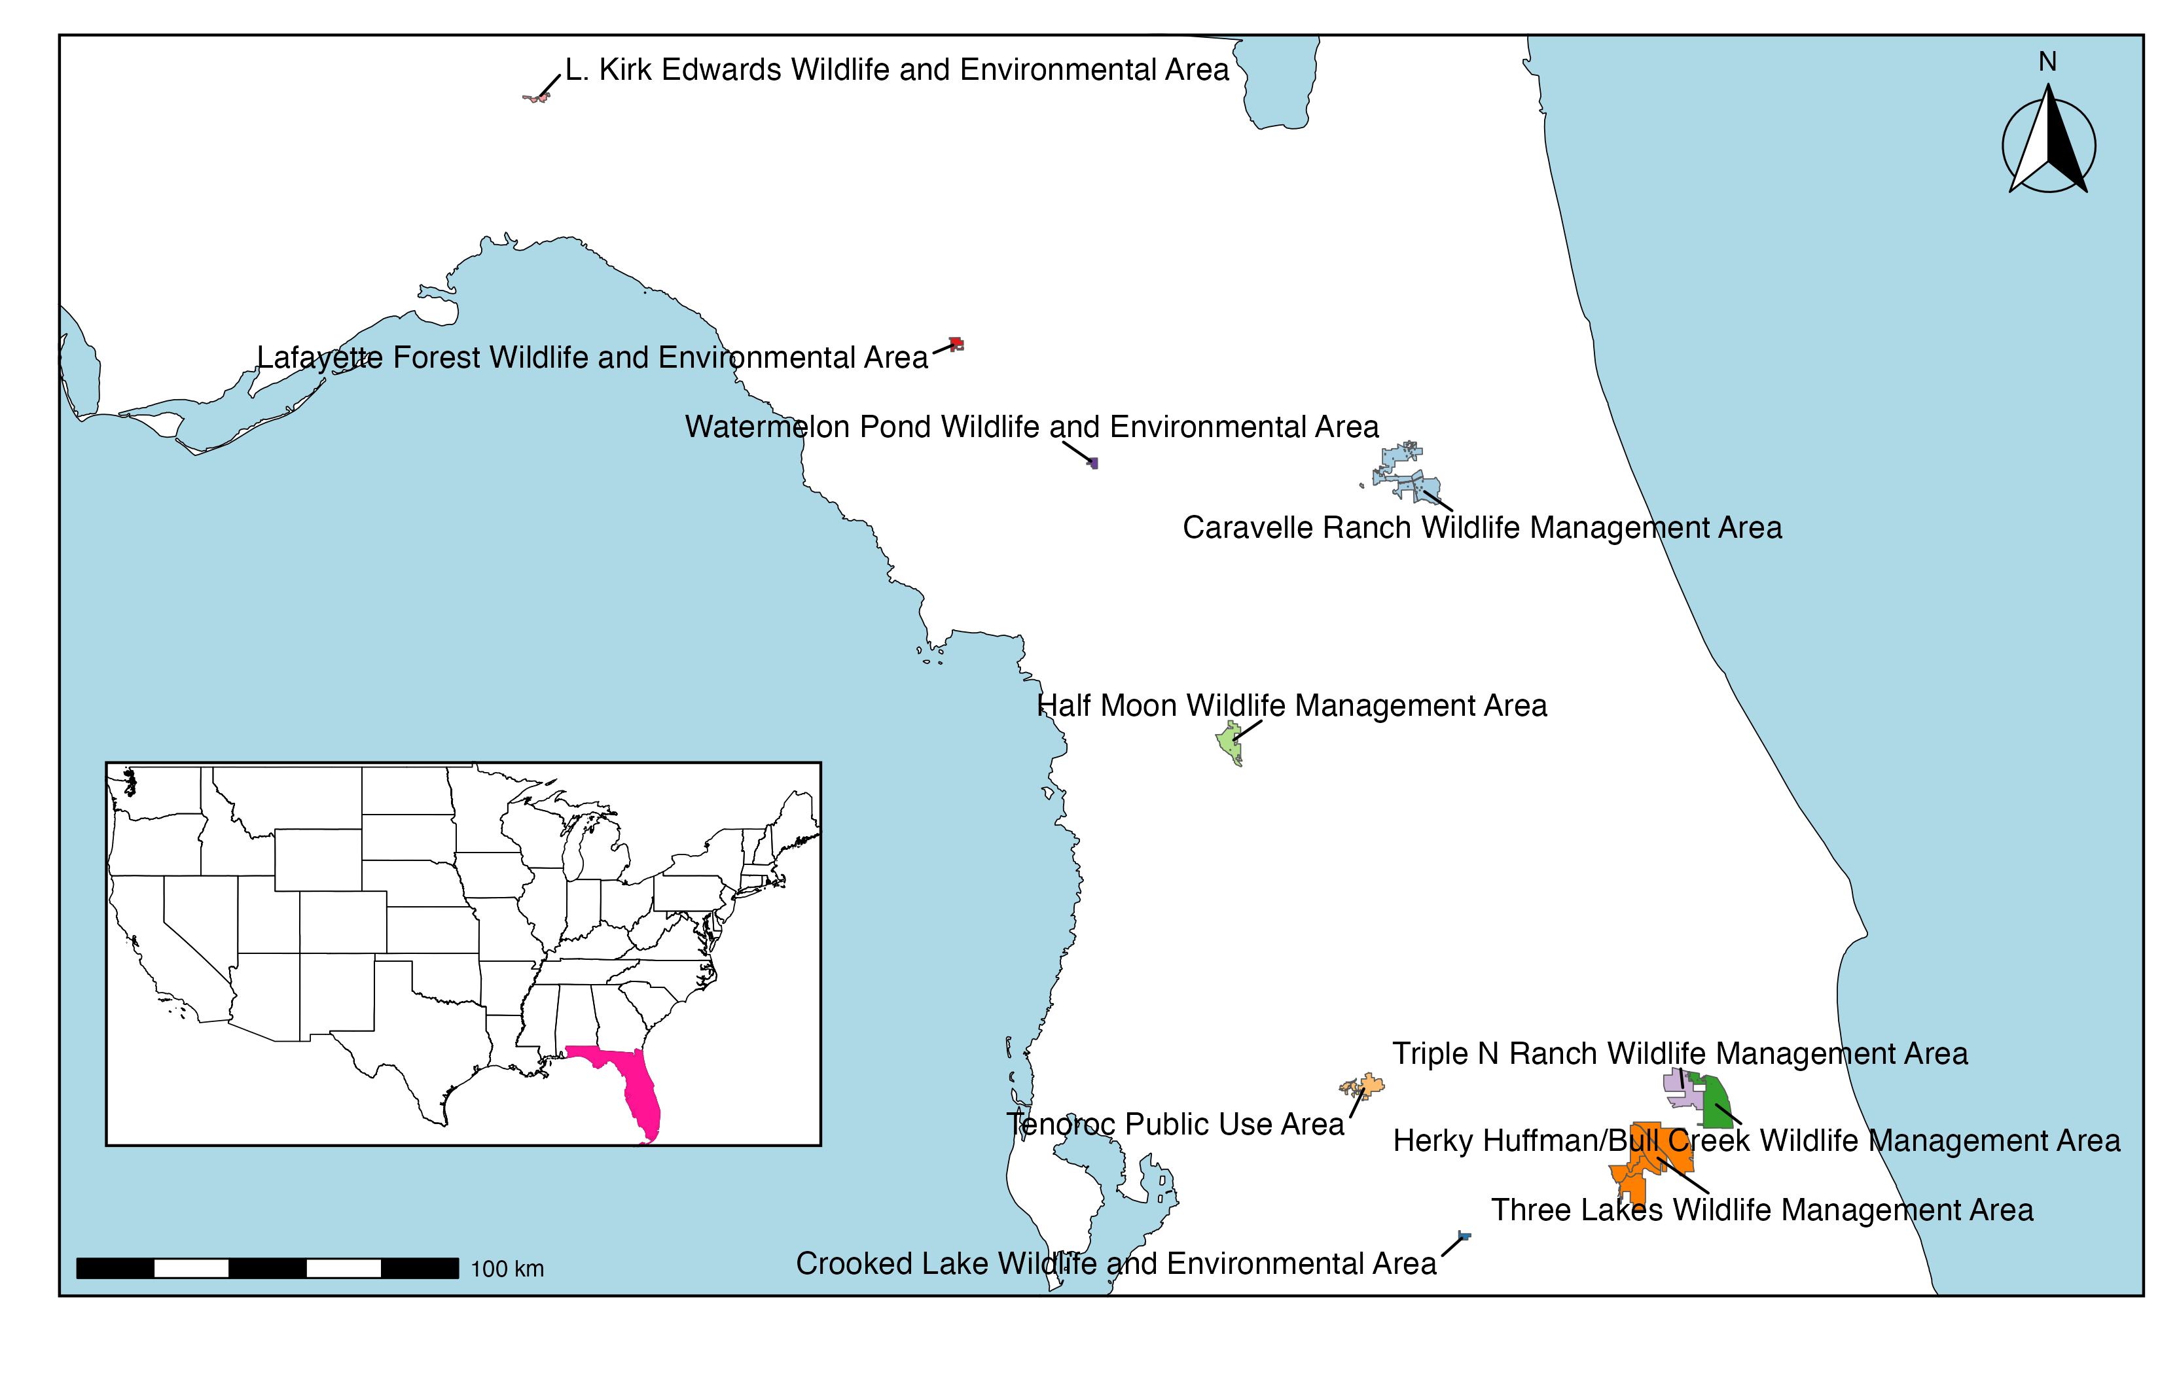

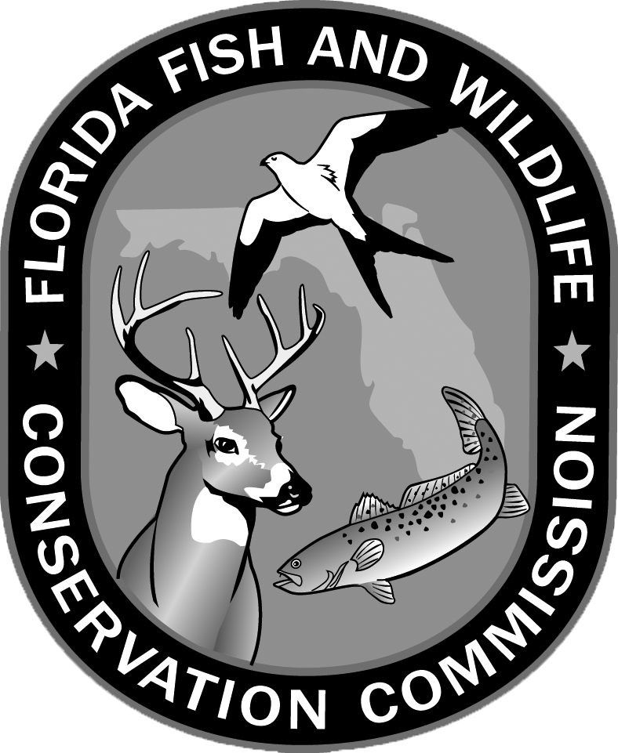


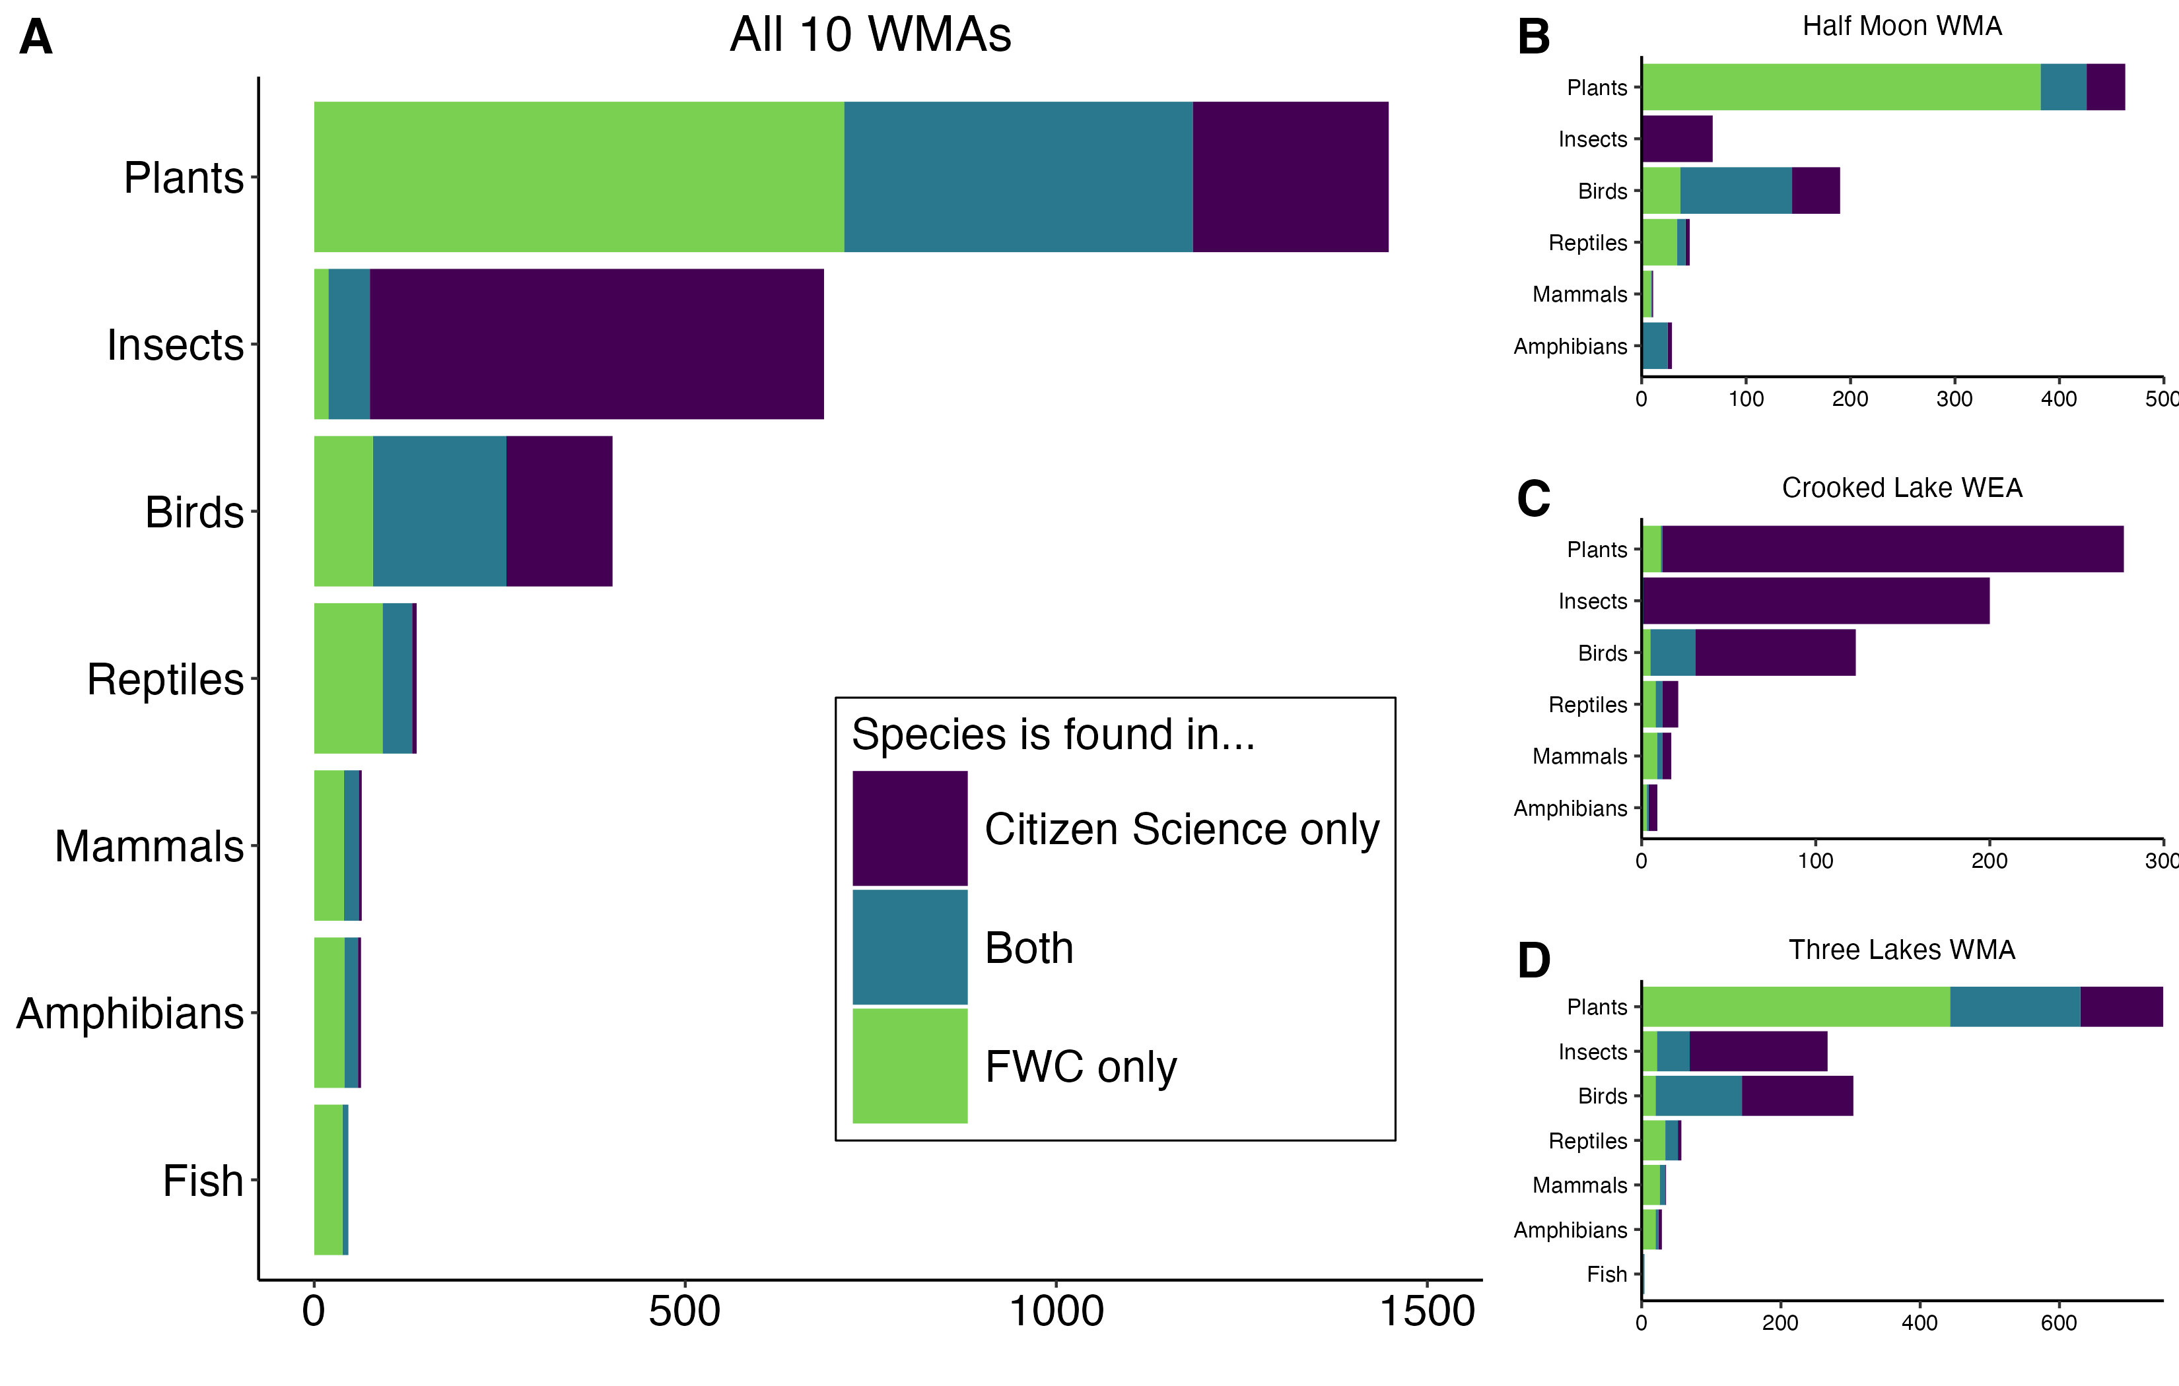
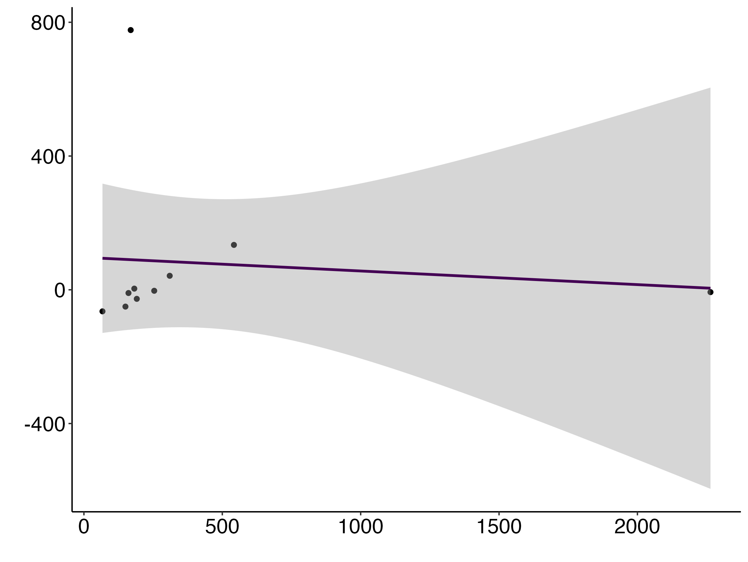
Assessing the complementarity of citizen-science data and state wildlife agency data for species inventories in Wildlife Management Areas
Samantha Lowe¹, Brittany M. Mason², and Corey T. Callaghan^{1,2}
¹School of Natural Resources and Environment, University of Florida
²Department of Wildlife Ecology and Conservation, University of Florida
Introduction
The Florida Fish and Wildlife Conservation Commission (FWC) is a state agency that is the landowner and/or lead managing agency for ~50 Wildlife Management Areas (WMAs) in the state of Florida.
There are over 100 additional cooperatively managed WMAs in Florida.
The FWC publishes Management Plans for lead WMAs every 10 years which contain species lists based on agency-conducted species inventories.
As a preliminary assessment, we examined how species lists created by the FWC for 10 WMAs compare to the lists of species in each WMA generated by citizen science observations from iNaturalist and eBird.
Research Questions
Can citizen science data be used in conjunction with state agency data to create more complete species inventories in Wildlife Management Areas?
Are there any types of species/taxa that citizen science and/or state agency data favor?
What qualities of WMAs lead to differences in the contents of citizen science species inventories and state agency species inventories?
n = 1 n = 1 n = 752 n = 18 n = 10 n = 8 n = 2
Percent of species
IUCN Conservation Status
Figure 3. Across all 10 WMAs, 792 species have IUCN-reported conservation statuses. No notable trends exist with this preliminary data. More than 2,000 species in WMAs have no IUCN status.
Results
Discussion
Citizen science data could improve the completeness of species lists in Management Plans without increasing the burden on state agencies.
In this preliminary research, citizen science data appears to consistently provide otherwise undocumented insect species.
We hope to learn more by expanding this research to include other WMAs and other state-managed land with species inventories like state parks.
2,961 species across all 10 WMAs
1,819 species recorded by the FWC
&
1,937 species recorded by the citizen scientists
Figure 1. Map of 10 WMAs in Florida for which the FWC is the lead managing organization.
Methods
Chose 10 WMAs with Management Plans published after 2017 (when the FWC started conducting species inventories to make species lists).
Extracted and aggregated species lists published in FWC Management Plans for each WMA.
Created ‘Citizen Science’ species lists for each WMA based on ‘Research Grade’ iNaturalist observations and eBird observations.
Percent difference between citizen science species count and FWC species count
Species Count
Species Count
Figure 2. Across all 10 WMAs (A), citizen science data adds novel species of plants, insects, and birds to the aggregated species list. The role of citizen science and FWC data for different taxa varies among individual WMAs (B,C,D).
Number of citizen science observers
Figure 4. The number of citizen science observers in each WMA has a weak effect on the percent difference between citizen science and FWC species counts.

